Slide 1

Week of 10/30 Deliverables
Red Lemurs

Slide 2
Deliverables
Lemur library alpha
notebook
Run Eric’s pipeline on fMRI data
Notebook, Literature Scoping
Fitting AR(1)
https://github.com/NeuroDataDesign/lemur-f17s18/blob/master/docs/vidurkailash/ndd-lemurs-10-29.pdf

Slide 3
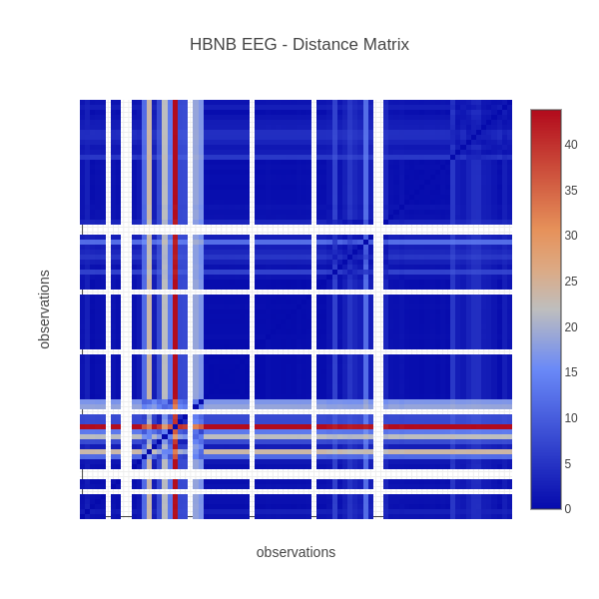
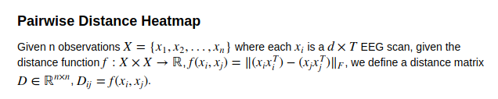

Distance Between EEG Scans😄notebook
(labels are viewed by hovering over matrix cells)

Slide 4

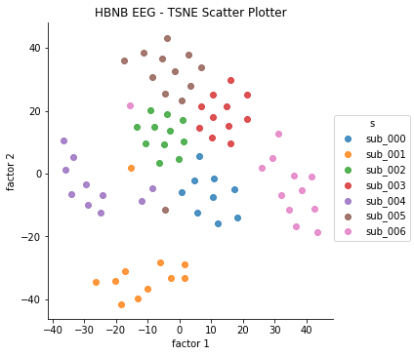
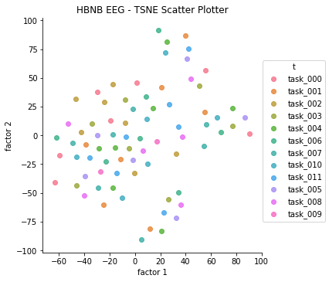
Visualizing the Pairwise Distances in 2D notebook
Colorized by Subject
Colorized by Task

Slide 5

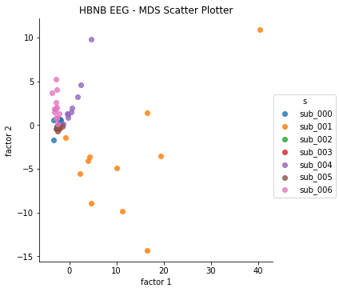
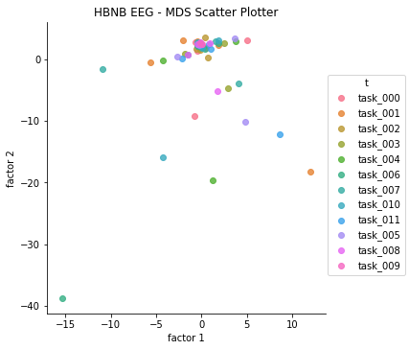
Visualizing the Pairwise Distances in 2D notebook
Colorized by Subject
Colorized by Task

Slide 6
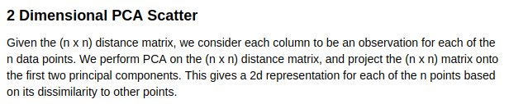
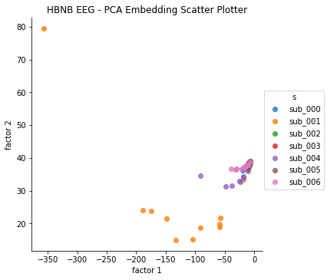
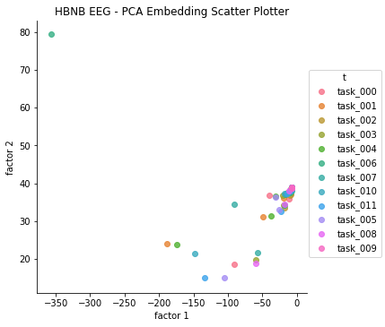
Visualizing the Pairwise Distances in 2D notebook
Colorized by Subject
Colorized by Task

Slide 7
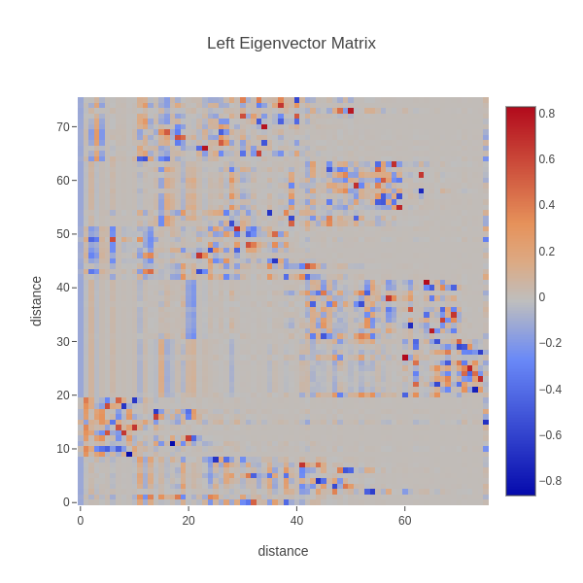

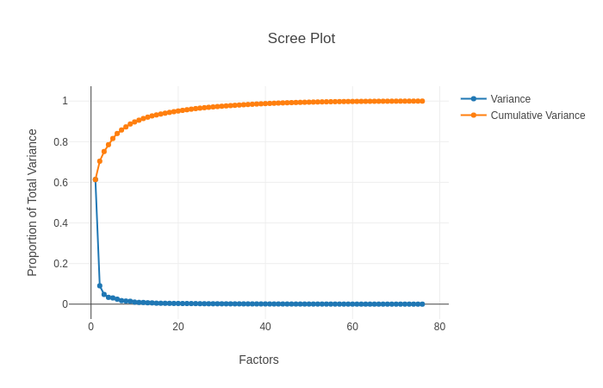
Visualizing Spectral Info of the Pairwise Distance Graph notebook

Slide 8

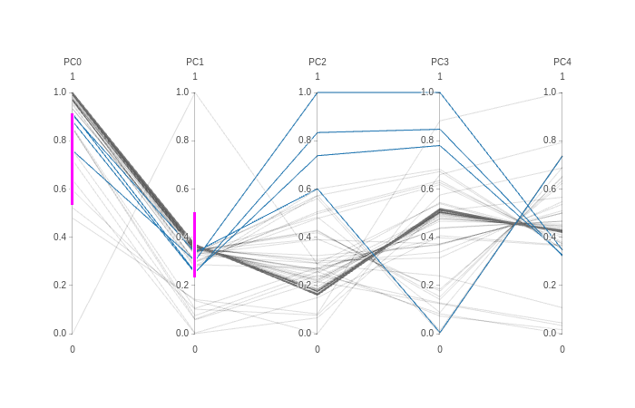
Other Misc. Plots notebook
You can filter which lines are colored blue.

Slide 9


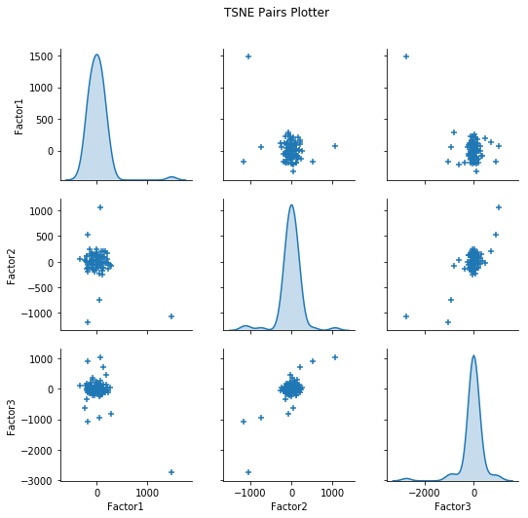
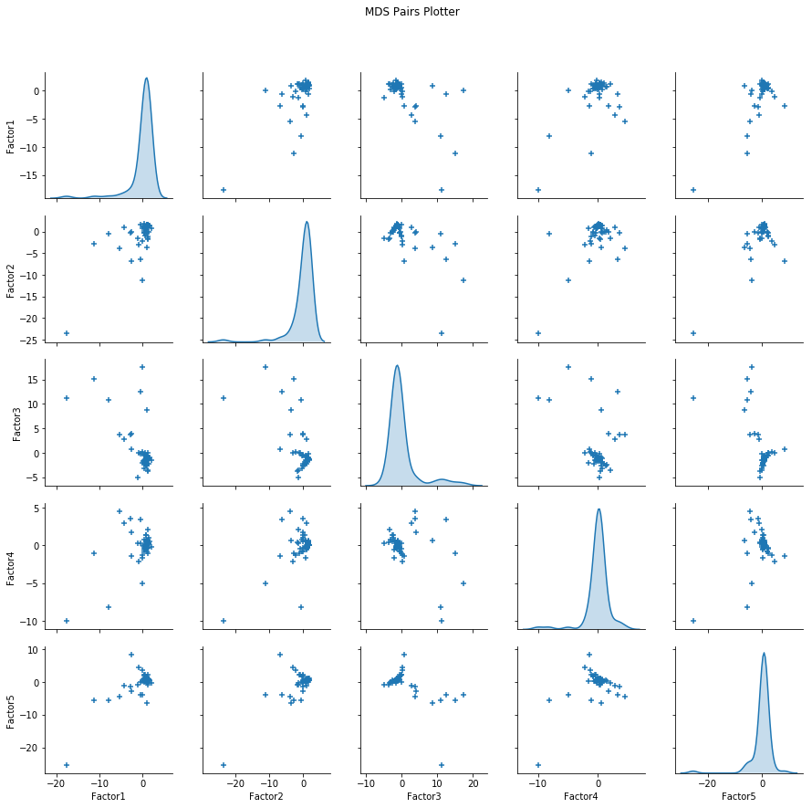
Other Misc. Plots notebook

Slide 10
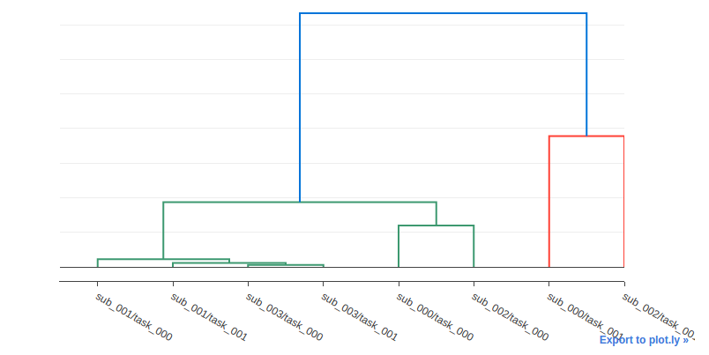
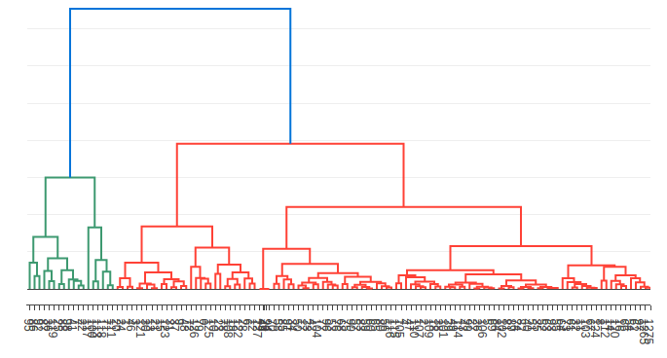
Other Misc. Plots notebook
4 Subjects 2 Paradigms
Subject NDARAA075AMK

Slide 11


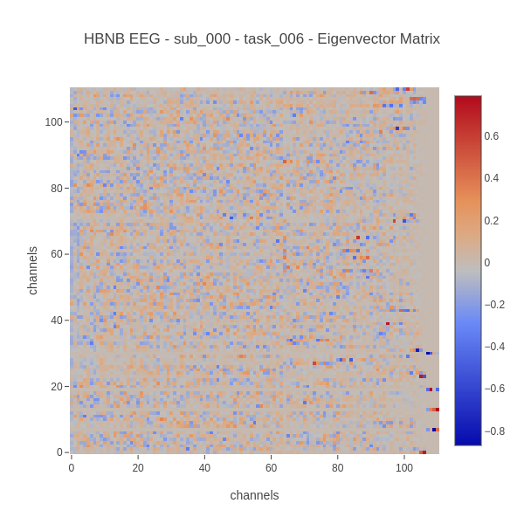
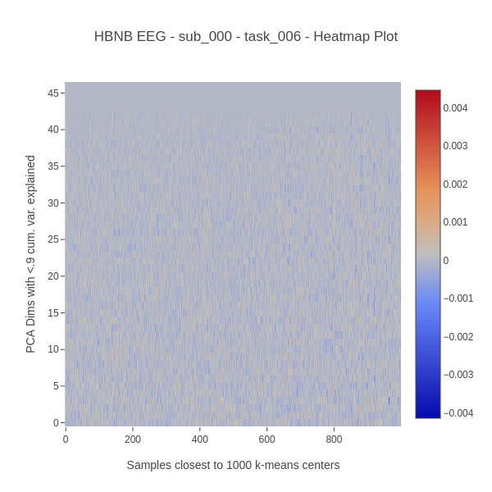
Plotting Single Trials of EEG Data notebook

Slide 12

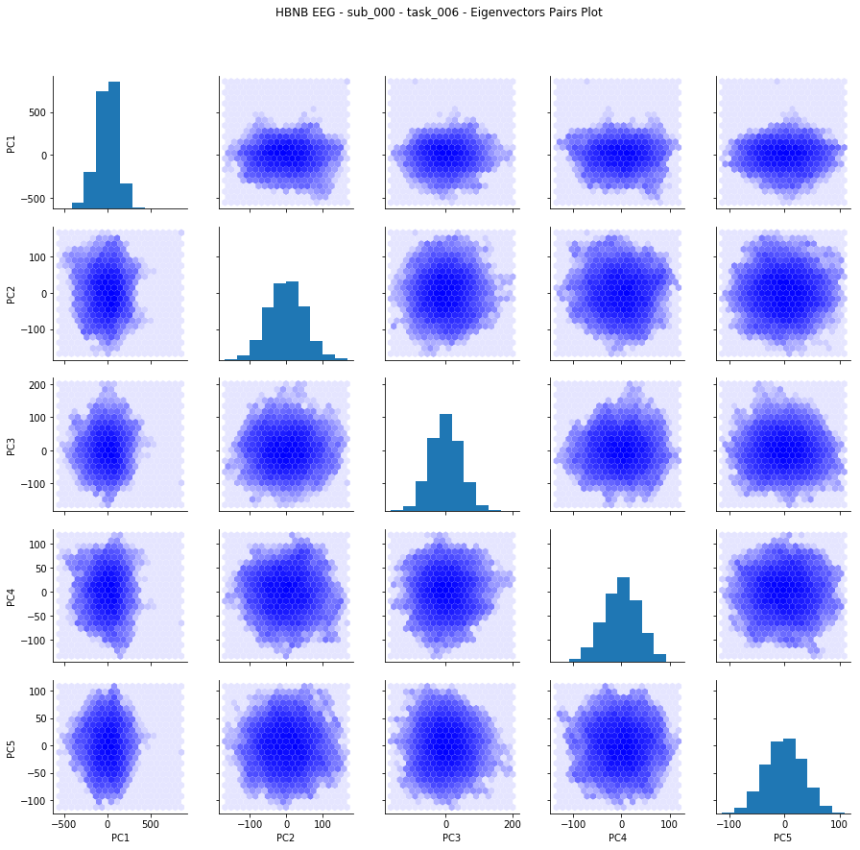
Plotting Single Trials of EEG Data notebook

Slide 13
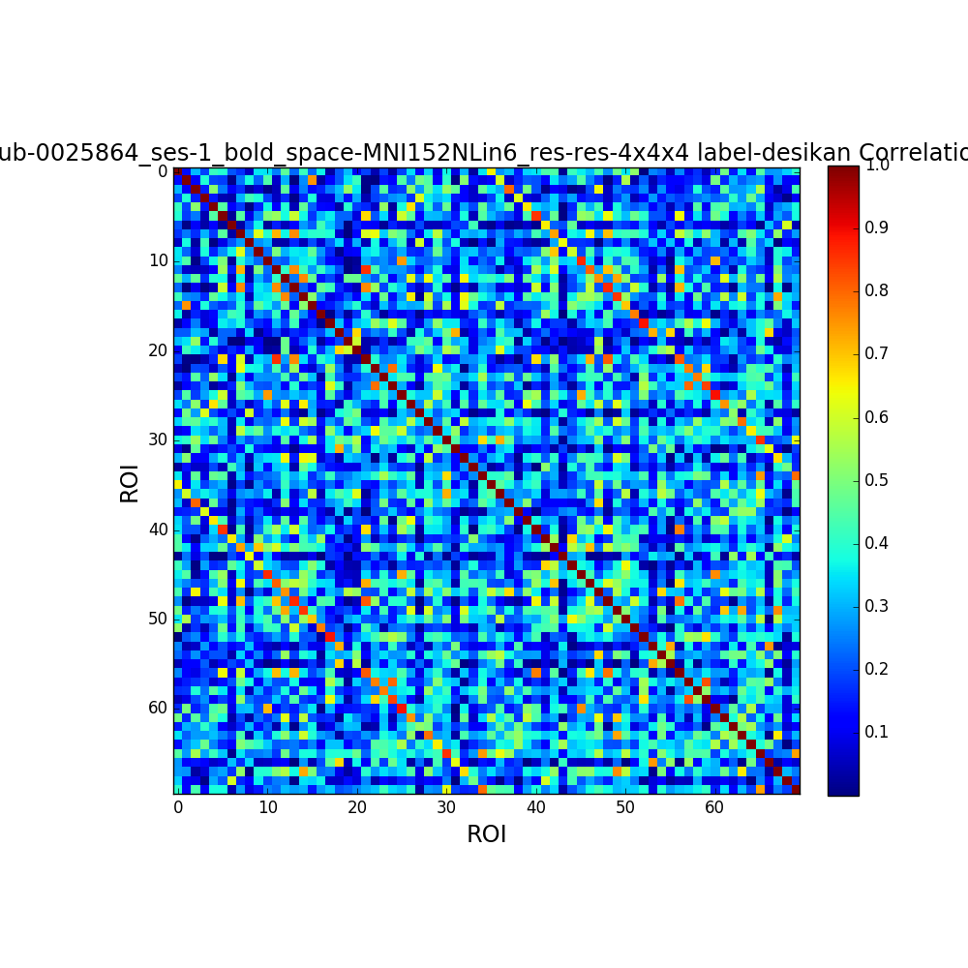
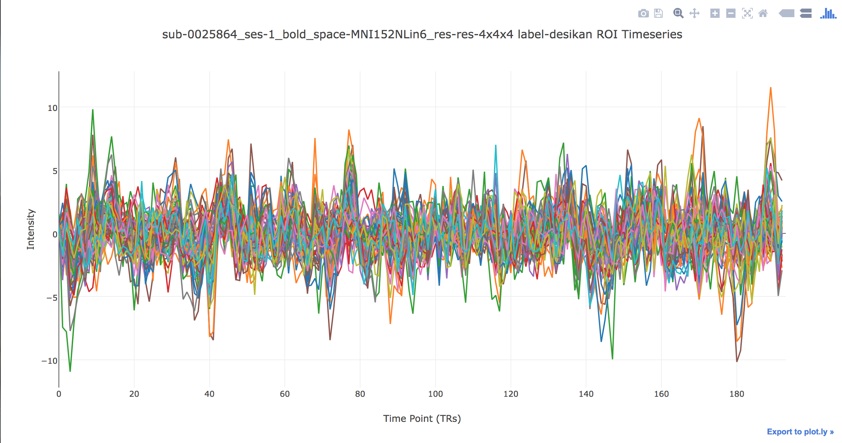
Run Eric’s pipeline on fMRI data Notebook
Correlation Matrix
Time Series Plot

Slide 14
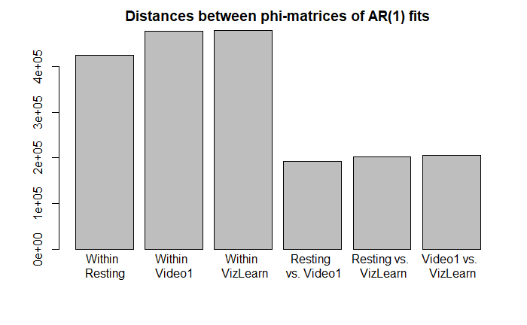
AR(1) Fitting
AR(1) fitting for 15 time series. Within each paradigm - calculate norm of pairwise distance matrices and then averaged them. Between each paradigm - average all matrices for each paradigm and then calculate pairwise distances. Distance is much higher for within than between.

Slide 15
Sprint 1 Progress
Scope problems from literature
EEG Biomarkers
fMRI Biomarkers (connectivity)
Analysis of survey data (p-factor)
Lemur Alpha Library
Need more modality specific plots for single data point to single plot (spatial + temporal)
Flattened EEG Heatmap
Graph of fMRI connectivity between ROIs
Iterate on aggregate plots, add Energy Distance and AR as a metric.
Lemur Demo Notebook
Need to run on fMRI data also, run on larger datasets (15+ EEG subjects)
Uniform plotting aesthetic & API
API examples in demo notebook, all plotly except 1-2 plots which will be switched over.

